Slide 1
Replicated Data Storage A totally ordered multicast based solution

Slide 2
THE PROBLEM
Distributed data storage
Multiple known servers
Same LAN
Sequential consistency
Read & Write primitives

Slide 3

Distributed data storage
The software architecture emulates the presence of a DB by using a HashTable to save the data in the tuple format < id, value >.
Both the id and the value are integer numbers and can be written or read using the corresponding primitives. Each server owns a private, consistent copy of the dataset.

Slide 4
Multiple known servers
The servers’ number is fixed and known a priori.
Servers are assumed to be reliable.

Slide 5
Same LAN
All the messages are exchanged on the same LAN using:
multicast messages on the multicast group 224.0.5.1
point to point messages between threads

Slide 6
Sequential consistency
The distributed data set is granted to be consistent due to the implementation of a sequential consistency model.
Such a model is achieved by means of a totally ordered multicast primitive

Slide 7
Read & Write primitives
Client requests can be writes (int id, int value) or reads (int id).
Writes are performed in perallel across all the servers while reads only happpen locally and are processed by the server the client connects to

Slide 8
The model

Slide 9
The software architecture makes use of active replication to keep the consistency among the servers’ datasets

Slide 10
Writes are submitted to the server the client connects to. Then, such server multicasts the message on the LAN to the other members of the group

Slide 11
Reads are performed locally and directly by the server the client has submitted the request to

Slide 12
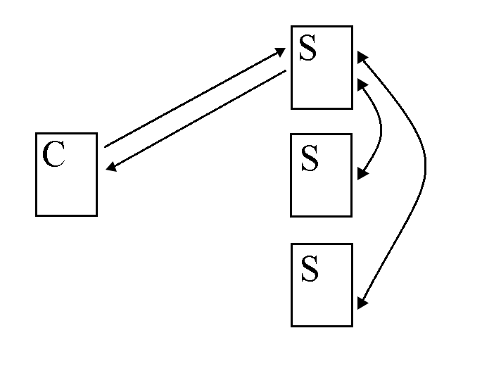

Slide 13
Totally ordered multicast

Slide 14
Every message that reaches the server is signed with a unique scalar clock from the local machine, is added to the local queue (sorted) and then is multicasted.

Slide 15
Every server receiving the multicasted message adds it to the local queue (sorted) and sends an ack still in multicast. Once a server has the acks from all the participants, it executes the message

Slide 16
FIFO ordering is achieved using local clocks. Each server has an independent local clock unique for every message. Messages are accepted only in sequental local clock order from a same source

Slide 17
To guarantee the FIFO ordering, messages that arrive out of order are dropped so to force a retransmission by the sender. This policy grants:
Security
Ease of management
Avoid reception of outdated messages

Slide 18
Furthermore, the OoO dropping policy makes retransmissions more robust. Indeed:
Old clock: message dropped
Right clock: message accepted
Future clock: message dropped

Slide 19
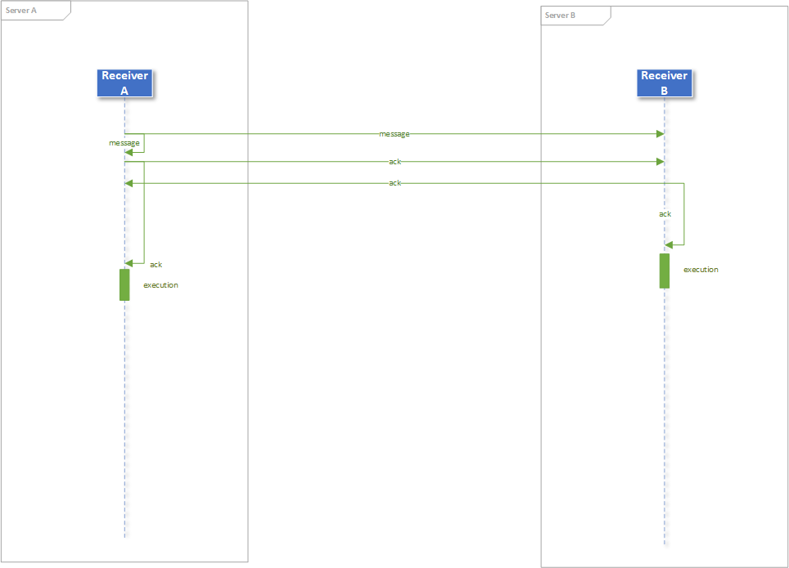

Slide 20
The architecture

Slide 21
The server architecture is made of 5 components:
Server: accepts client connections and assigns scalar clocks
Handler: handles the messages from the client, adds them to the local queue and multicasts them to the listening servers

Slide 22
Receiver: it’s the main component and includes the main logic to manage messages, acks and retransmissions
Ticker: sends the «unlock» messages every X seconds to avoid stalls in blocking primitives (messages acceptance)

Slide 23
Queue: contains the logic to manipulate the queues of messages and acks and executes reads and writes

Slide 24
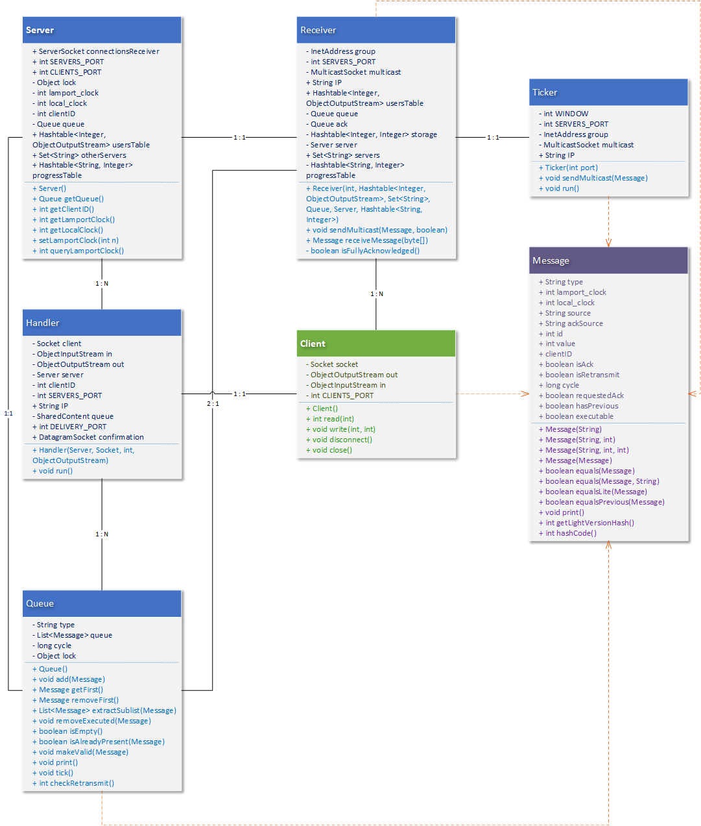

Slide 25
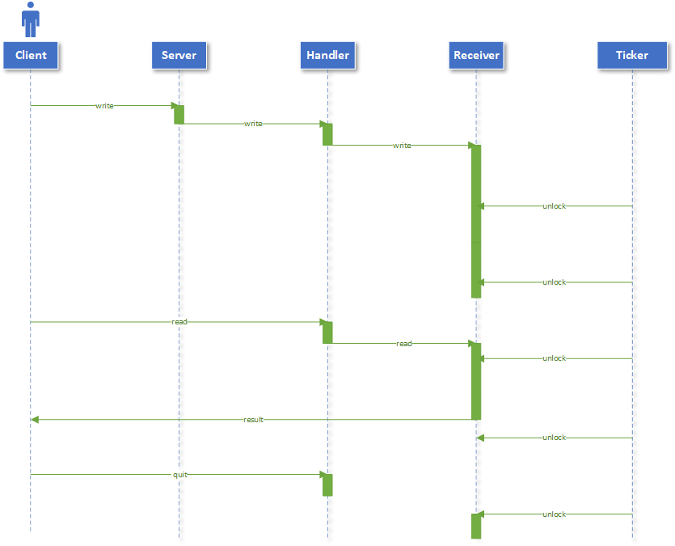

Slide 26
Thanks!
Any questions?

Slide 27


